Slide 1

KING COUNTY HOUSE PRICE PREDICTIONS

Slide 2
Table of contents
01
02
03
04
05
06
Business Problem
Data understanding
Objectives
EDA
Recomendition & Conclusions
Modeling

Slide 3
Business
Problem

Slide 4
BUSINESS PROBLEM
The real estate agency wants to provide homeowners with advice on how home renovations can potentially increase the estimated value of their homes and by what amount.
The agency aims to offer valuable insights to homeowners, helping them make informed decisions about renovation projects that can maximize their return on investment when selling their properties.

Slide 5

Introduction
As an employee for a real estate agency, I am analyzing information from the Kings County House Sales dataset. Given several factors from the dataset, I aim to provide advice to my agency on how home features will increase the values of homes in Kings County; more specifically, I aim to determine which home factors are the most lucrative. By understanding which factors increase a home's value, my agency will be able to successfully help homeowners sell their homes for a maximized profit.

Slide 6

03
OBJECTIVES
O

Slide 7
OBJECTIVES
To determine how much would adding an extension to the lot area of the home likely increase sale price.
To examine how much would adding an additional bathroom likely increase sale price.
To determine how much would adding an extension to the
living area of the home likely increase sale.
To examine how much would adding an additional bedroom to a house likely increase sale price.
5. To determine how much would adding an additional bathroom
to a house likely increase sale price.

Slide 8


Slide 9
Data Understanding
The data columns used were:
Bedrooms - Number of bedrooms.
Bathrooms - Number of bathrooms.
Condition - How good the overall condition of the house is.
Grade - Overall grade of the house, related to the construction and design of the house.
Price - This is the selling price of a house.
Sqft_lot - This is the square footage of the lot where a house is built on.
Sqft_living - Square footage of living space in the home.
Sqft_above - Square footage of house apart from basement.

Slide 10
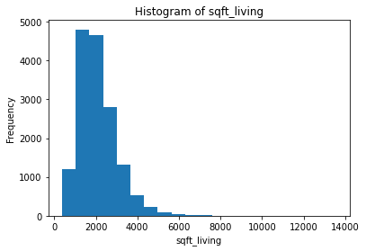
Histogram
Most of the houses Square footage of living space lies between 2000 to 4000 square feet.

Slide 11
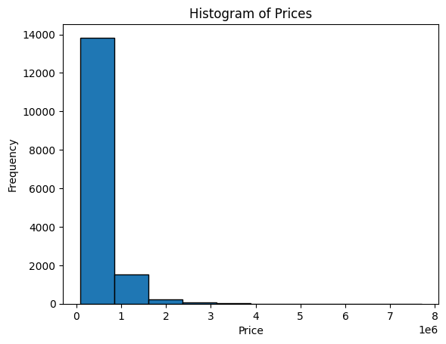
Histogram
The distribution of house prices shows that there are a large number of houses that are relatively inexpensive, but there are also a small number of houses that are very expensive

Slide 12
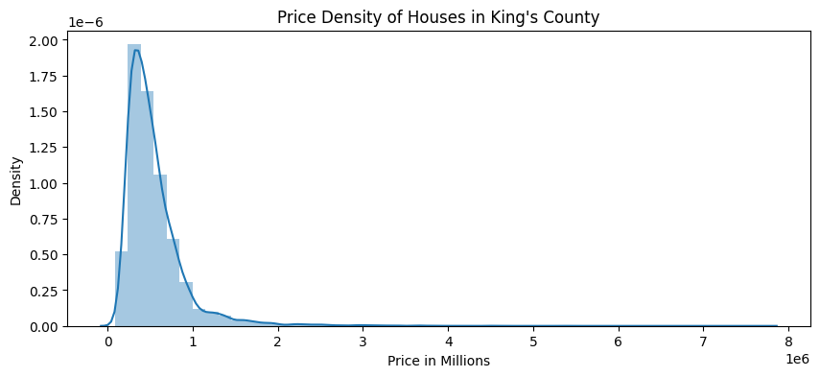
The distribution of house is right skewed

Slide 13
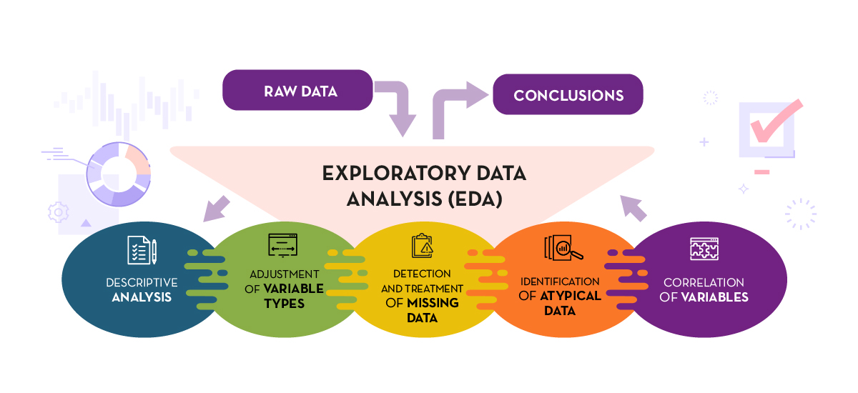
EDA

Slide 14
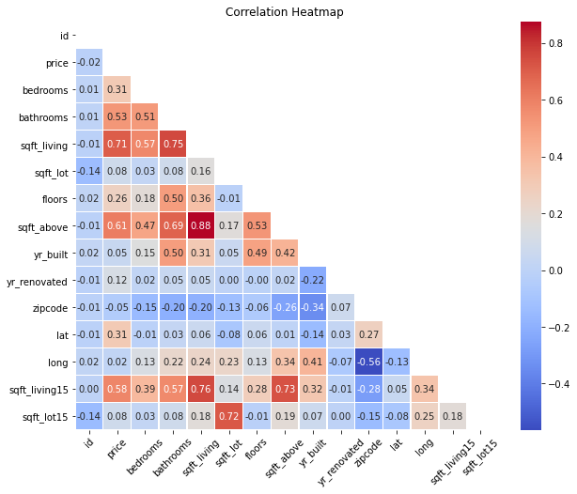

Slide 15

DATA MODELING

Slide 16
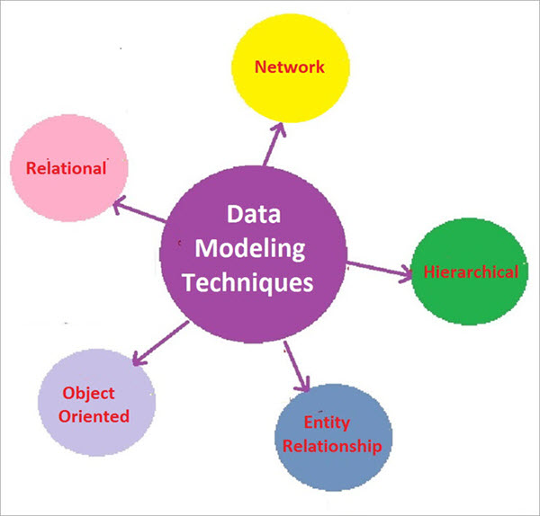
Simple Linear Regression - We created a model to predict price using Sqft ft living.
Multiple Linear Regression - We created another model to predict price using Sqft_living 15,bedrooms,bathrooms,sq ft lot15,floors,sq_ft above, grade number and basement.
Model created with outliers removed from features.
Model created with features log transformed.
Model created with onehotencode of zipcodes.

Slide 17
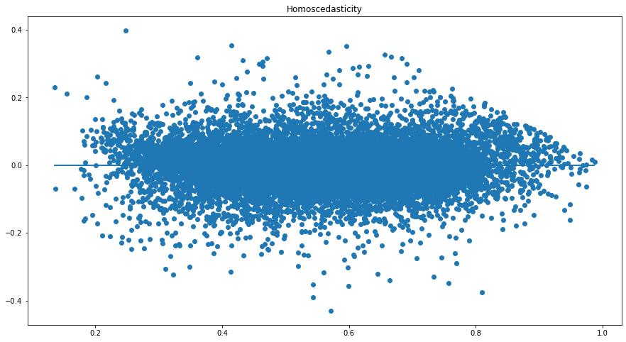

Slide 18
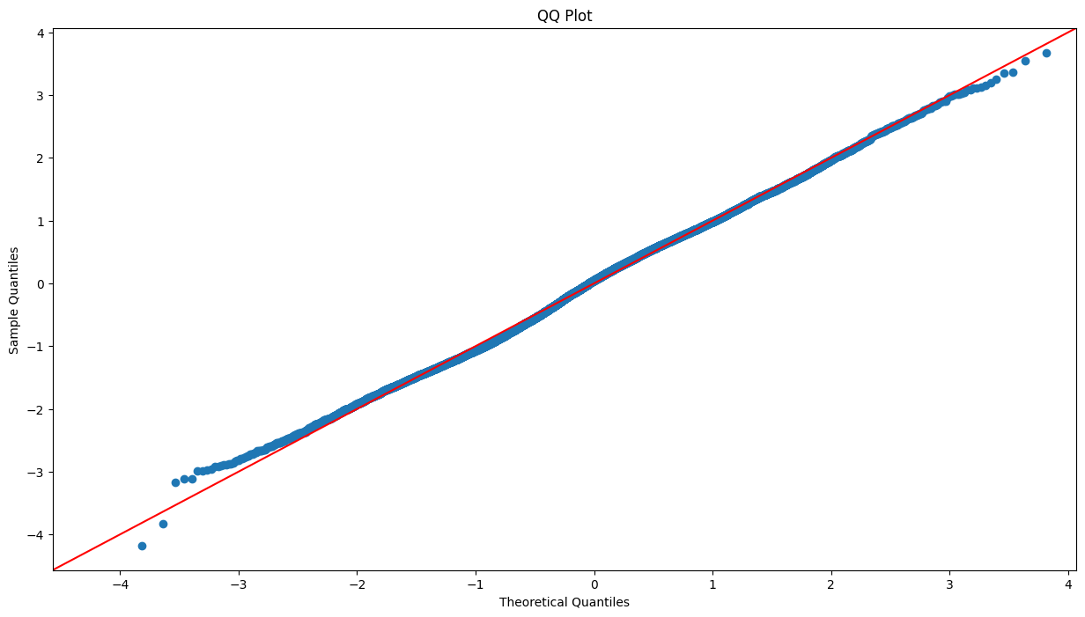

Slide 19
CONCLUSIONS
The model is generally statistically significant with an F-statistic p_value of 0.0 at a significance level of 0.05.
The R-squared value is 0.833, indicating that approximately 83.3% of the variation in the price can be explained by the model. This value indicates a great improvement from the previous model.
3. Also, of great importance to note is that the mean RMSE is approximately 0.06465. Then the RMSE in original scale is 0.1135. This means that our model is off by about 0.1135 when making an average prediction, indicating that it is a good model.

Slide 20
CONCLUSIONS
The coefficients represent the expected change in the price for a one-unit change in the corresponding predictor variable, assuming other variables are held constant.
ZIPCODE--is a strong predictor of a homes value, the saying "Location, Location, Location" holds true, as even in a similar area the location plays a huge factor in the value of a home.
The plot to test for homoscedasticity reveals that the residuals are now homoscedastic because they are converging and appear to be having an equal variance. So this assumption remains satisfied.
The QQ-plot is used to test for normality of residuals. In this case, the residuals appear to be almost normal as they are following along the line almost neatly, except for the ends where it indicates there could be some skewness in the data.

Slide 21
RECOMENDITIONS
The real estate agency should explore properties that occupy a large square foot of the lot since most people would rather source a relatively large proportion of land .
As per our EDA we see that houses with more bathrooms and floors are likely to be more in demand which in turn generates more revenue from purchasing and renting, therefore the agency should check on property managers who are investing on the property architectural design.
The real estate agency should look into properties with more square foot of living since more people are likely to occupy them.

Slide 22

KINGS COUNTY HOUSES

Slide 23

Thanks!

